Slide 1
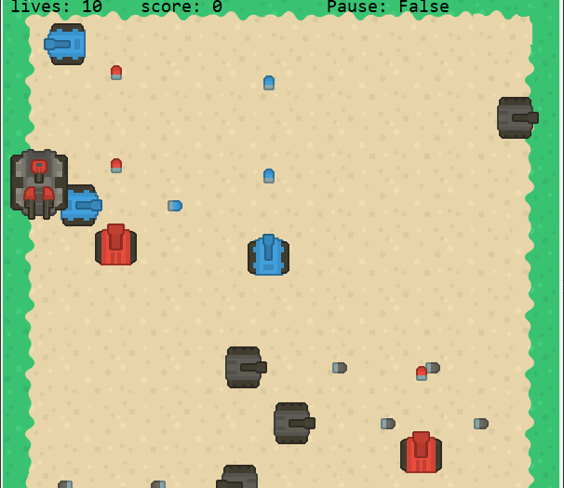
Tank War
A 2D AI Confrontation Game
Present by Xi Zhu

Slide 2
Agenda
Team Member Roles and Responsibilities
Improvements made from Professor Feedback
Problem Statement
Project Description
Team working agreement
Personas
MVP (Minimal Viable Product)
Technologies
Algorithms
Diagrams
Sprint 1 (CS692) Recap
Product Backlog
Sprint 2 Backlog
Metrics
Retrospective
Sprint 2
Project Demo - Sprint 2 ( current sprint)
Live Project Demo & GitHub link

Slide 3
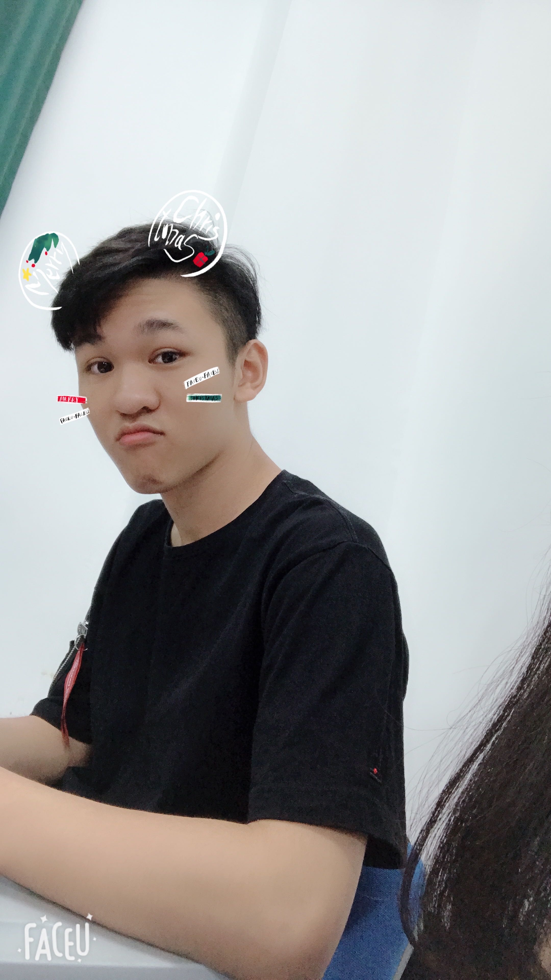
Team Member Roles and Responsibilities
Responsibilities:
Define the Product Vision and Strategy
Create a Product Roadmap
Prioritize Product Backlog
Write and Test Codes
Collect User Feedback
Measure Product Success
Xi Zhu
Product Manager

Slide 4
Improvements made from Professor Feedback
In the previous Sprint forgot the collection API and uploaded
Review project requirements more frequently to better accomplish tasks.

Slide 5

Problem Statement
The problems of simple playability, uneven quality, and inoperability of traditional 2D Battle Games, it is difficult for players to obtain a satisfactory game experience.

Slide 6
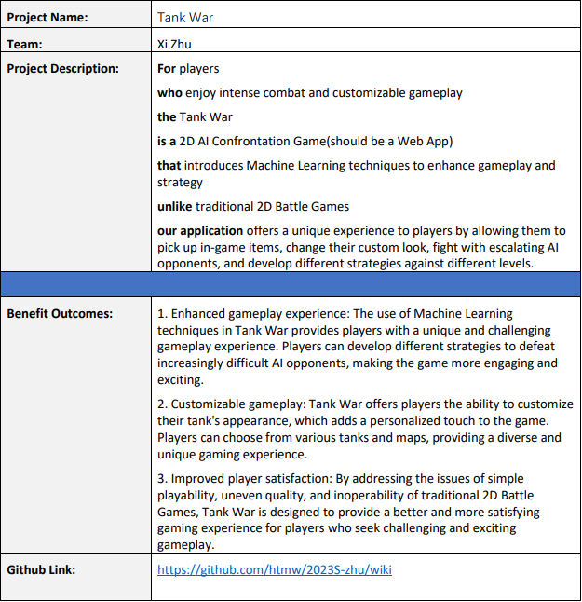
Project Description

Slide 7
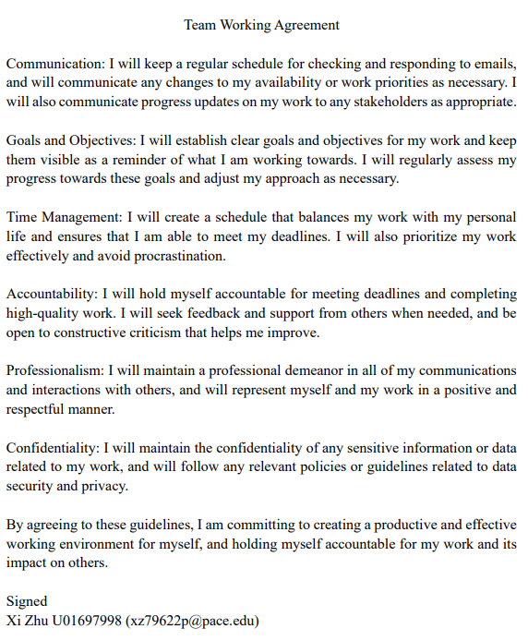
Team Working Agreement
Communication
Goals and Objectives
Time Management
Accountability
Professionalism
Confidentiality

Slide 8

Personas

Slide 9
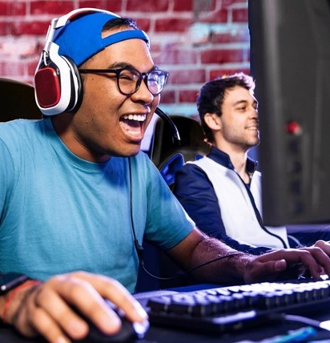
Persona 1 - Gaming Enthusiast Gary
Name: Gary Carlos
Age: 22
Job: College Student
Profile:
Gary is a 22-year-old college student who is a passionate gamer. He spends most of his free time playing video games and loves games that offer a challenging and rewarding experience.
Frustration and Goals:
Gary is frustrated with games that are too easy or lack replayability. He is always looking for new games that provide an engaging and immersive experience.
His goal is to find a game that he can play for hours on end and continue to enjoy.

Slide 10
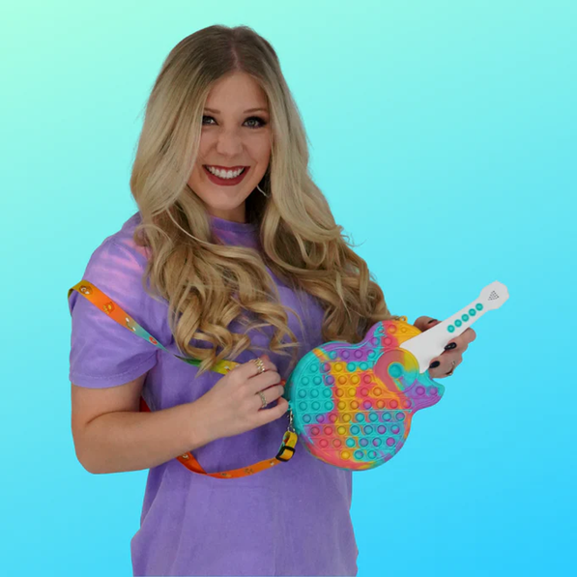
Persona 2 - Busy Bee Brianna
Name: Brianna Mary
Age: 32
Job: White-collar Employee
Profile:
Brianna is a 32-year-old working professional who enjoys playing games in her downtime. She has a busy schedule and often finds herself with limited free time.
Frustration and Goals:
Brianna is frustrated with games that require a lot of time commitment or are too complex to understand quickly.
Her goal is to find a game that she can pick up and play for short periods of time and still enjoy. She likes games that are easy to learn but still offer a challenge.

Slide 11

Persona 3 - Competitive Cam
Name: Cameron Nguyen
Age: 26
Job: Game Anchor
Profile:
Cam is a 26-year-old gamer and game anchor who loves playing competitive games. He livestreams his games on YouTube everyday.
Frustration and Goals:
Cam is frustrated with games that don't offer a fair playing field or are too easy to win.
His goal is to find a game that he can compete in at a high level and feel challenged by. He likes games that have a competitive scene and allow him to measure his skills against other players.

Slide 12
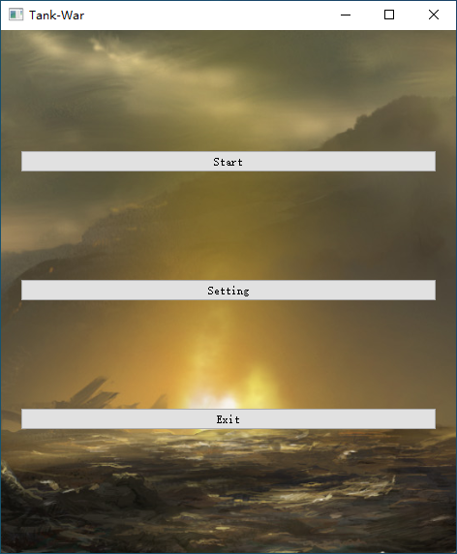
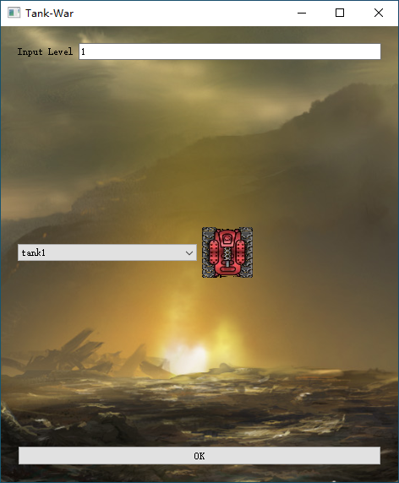
MVP (Minimal Viable Product)

Slide 13
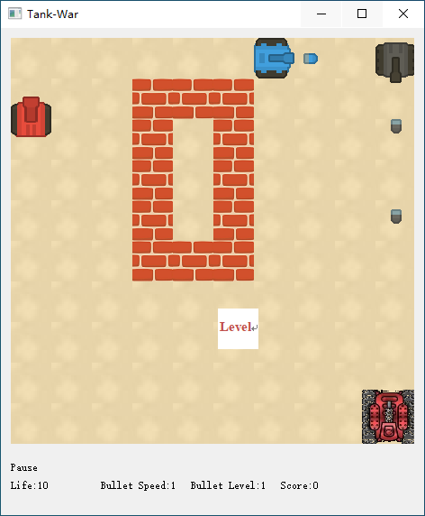
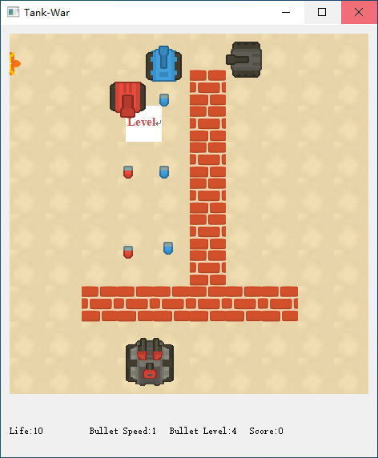
MVP (Minimal Viable Product)

Slide 14

Technology Tools

Slide 15
Algorithm – Reinforcement Learning(RL)
Define Actions:
In short, we define the actions that the AI agent can take in the game.
For example, in a tank game, the AI agent can move the tank left and right, aim and shoot at the player's tank, and even shoot at the player's tank from behind cover.

Slide 16

Diagrams

Slide 17
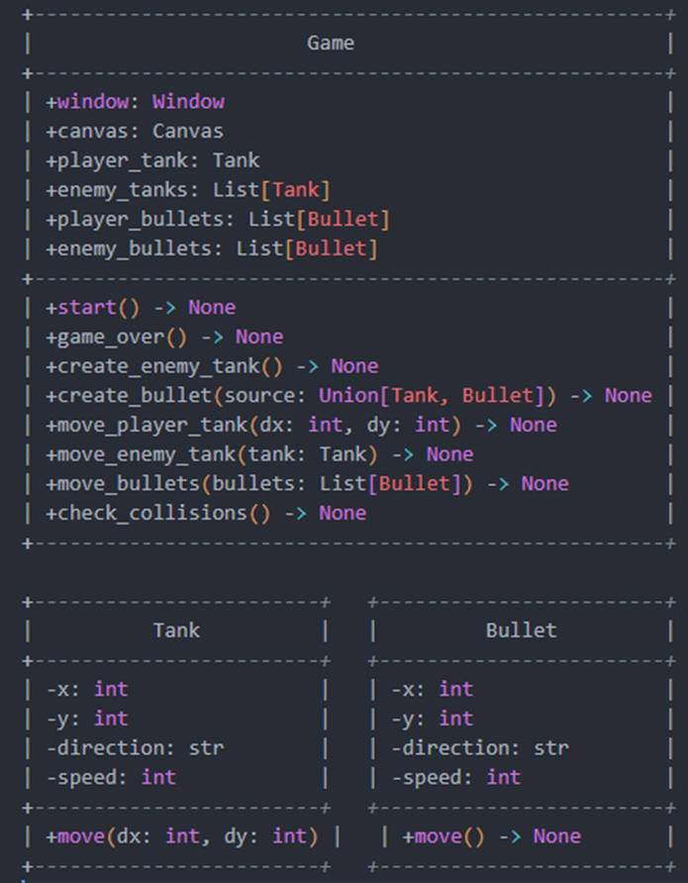
Conceptual Diagram

Slide 18
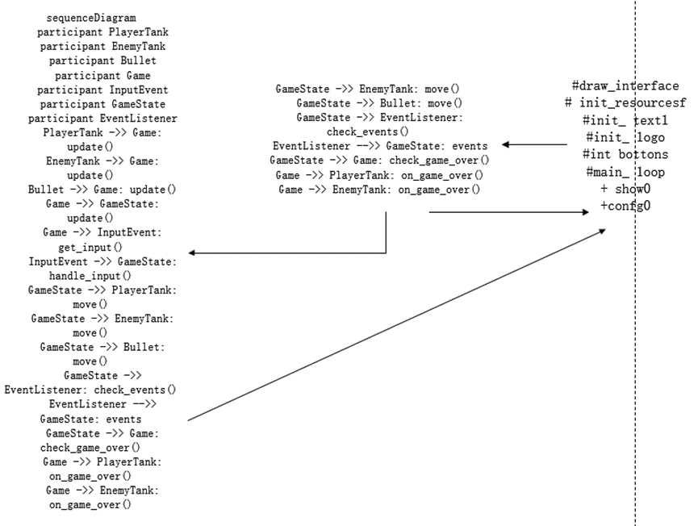
Sequence Diagram

Slide 19
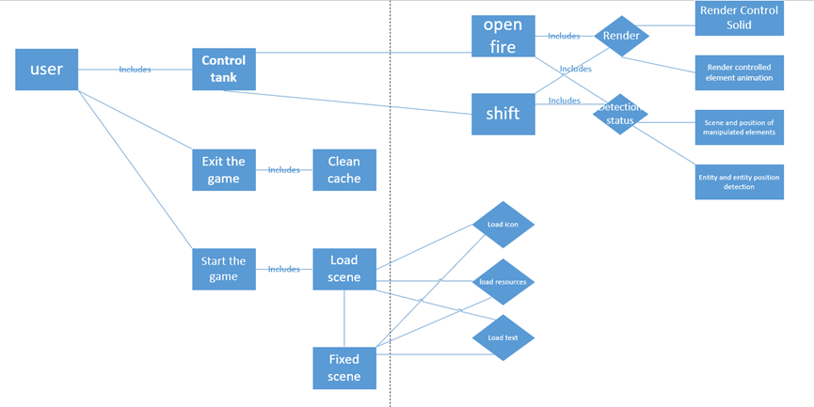
Use Case Diagram

Slide 20
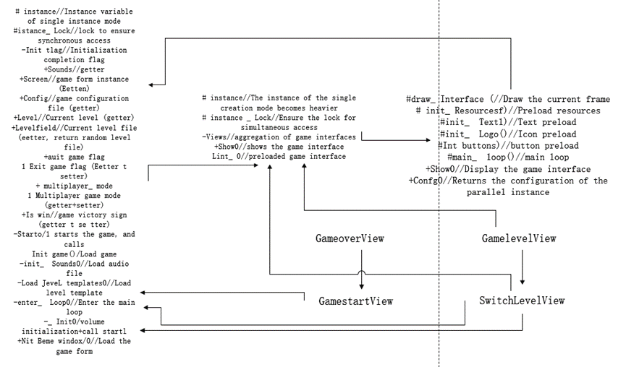
Class Diagram

Slide 21
Sprint 1 Recap
Sprint 1 Completed User Stories
ID | As a | I want to | So that | Acceptance Criteria (format: use keywords Given, When, Then) | Status
US 1 | Player/ Customer | control a tank with a keyboard | I can move around the battlefield and engage in combat with other tanks. | Scenario: Tank Movement Given: The player is on the game screen When: The player presses the arrow keys on the keyboard to control the tank's movement Then: The tank moves in the direction of the arrow key that was pressed. | Completed
US 2 | Player/ Customer | fire my tank's cannon | I can destroy enemies' tanks. | Scenario: Firing the Cannon Given: The player is on the game screen When: The player presses the spacebar on the keyboard to fire the cannon Then: The tank fires a shell in the direction it is facing. | Completed
US 3 | Player/ Customer | have a single-player mode | I can practice my skills and strategies against AI-controlled tanks. | Scenario: Single-player mode Given: The player is on the game screen When: The player selects the Game Start option Then: The game starts in single-player mode, with AI-controlled tanks as enemies and allies. | Completed
US 5 | Player/ Customer | have enemies and allies | I can experince different situtations and have more fun | Scenario: Enemies and Allies Given: The player is on the game screen When: The game starts Then: Enemies and allies are present on the battlefield, and the player can differentiate between them. | Completed
US 6 | Player/ Customer | have a scoreboard that shows my score | I can see how many score I get. | Scenario: Scoreboard Given: The player is on the game screen When: The game is in progress Then: The scoreboard displays the player's score | Completed
US 7 | Player/ Customer | have multiple lives | I'm not gonna let one mistake end the game | Scenario: Multiple Lives Given: The game is in progress When: The player's tank takes damage Then: The tank loses a life, and the player can continue playing with the remaining lives. | Completed
US 12 | Player/ Customer | have different kind of enemies | enrich my game experience | Scenario: Different Types of Enemies Given: The game is in progress When: The player encounters different types of enemy tanks Then: The player experiences a variety of gameplay challenges. | Completed
US 15 | Player/ Customer | see the lives status of my tank | I can know how much damage I can sustain | Scenario: Lives Status Given: The game is in progress When: The player's tank takes damage Then: The lives status of the tank is updated to reflect the remaining health. | Completed
US 19 | Player/ Customer | want enemies and friends to respawn constantly | I can constantly encounter new situations to enrich my experience | Scenario: Enemy respawn Given: The player starts a game When: The player destroys an enemy tank Then: A new enemy tank immediately appears on the battlefield When: The player's ally tank is destroyed Then: A new ally tank immediately appears on the battlefield | Completed
US 10 | Player/ Customer | play on different difficulty levels | I can challenge myself and get different experiences. | Scenario: Difficulty Levels Given: The player is on the game screen When: The player selects a difficulty level Then: The game's difficulty is changed, and the player experiences a different level of challenge. | Not Completed
US 11 | Player/ Customer | my shells to score differently when they hit friendly and enemy forces | affecting my strategy and scoring. | Scenario: Shell Scoring Given: The player's tank fires a shell When: The shell hits an enemy tank Then: The player scores points. If the shell hits a friendly tank, the player loses points. | Not Completed

Slide 22
Product Backlog
ID | As a | I want to | So that | Acceptance Criteria (format: use keywords Given, When, Then) | Status | Sprint
US 1 | Player/ Customer | control a tank with a keyboard | I can move around the battlefield and engage in combat with other tanks. | Scenario: Tank Movement Given: The player is on the game screen When: The player presses the arrow keys on the keyboard to control the tank's movement Then: The tank moves in the direction of the arrow key that was pressed. | Done | 1
US 2 | Player/ Customer | fire my tank's cannon | I can destroy enemies' tanks. | Scenario: Firing the Cannon Given: The player is on the game screen When: The player presses the spacebar on the keyboard to fire the cannon Then: The tank fires a shell in the direction it is facing. | Done | 1
US 3 | Player/ Customer | have a single-player mode | I can practice my skills and strategies against AI-controlled tanks. | Scenario: Single-player mode Given: The player is on the game screen When: The player selects the Game Start option Then: The game starts in single-player mode, with AI-controlled tanks as enemies and allies. | Done | 1
US 4 | Player/ Customer | have a variety of maps to choose from | I can experience different terrains and battlefields. | Scenario: Choosing a Map Given: The player is on the game screen When: The player selects the map selection option Then: A list of available maps is displayed, and the player can select one to start the game on that map. | Done | 2
US 5 | Player/ Customer | have enemies and allies | I can experince different situtations and have more fun | Scenario: Enemies and Allies Given: The player is on the game screen When: The game starts Then: Enemies and allies are present on the battlefield, and the player can differentiate between them. | Done | 1
US 6 | Player/ Customer | have a scoreboard that shows my score | I can see how many score I get. | Scenario: Scoreboard Given: The player is on the game screen When: The game is in progress Then: The scoreboard displays the player's score | Done | 1
US 7 | Player/ Customer | have multiple lives | I'm not gonna let one mistake end the game | Scenario: Multiple Lives Given: The game is in progress When: The player's tank takes damage Then: The tank loses a life, and the player can continue playing with the remaining lives. | Done | 1
US 8 | Player/ Customer | have different language options | fit my language preferences. | Scenario: Language Options Given: The player is on the game screen When: The language selection option is available Then: The player can select a language preference, and the game's language will be changed accordingly. | Done | 2
US 9 | Player/ Customer | pause the game at any time | take a break or attend to other matters. | Scenario: Pausing the Game Given: The game is in progress When: The player presses the pause button Then: The game is paused, and the player can resume playing or exit the game. | Done | 2
US 10 | Player/ Customer | play on different difficulty levels | I can challenge myself and get different experiences. | Scenario: Difficulty Levels Given: The player is on the game screen When: The player selects a difficulty level Then: The game's difficulty is changed, and the player experiences a different level of challenge. | Done | 2

Slide 23
Product Backlog
US 11 | Player/ Customer | my shells to score differently when they hit enemy forces | affecting my strategy and scoring. | Scenario: Shell Scoring Given: The player's tank fires a shell When: The shell hits an enemy tank Then: The player scores points. If the shell hits a friendly tank, the player loses points. | Done | 2
US 12 | Player/ Customer | have different kind of enemies | enrich my game experience | Scenario: Different Types of Enemies Given: The game is in progress When: The player encounters different types of enemy tanks Then: The player experiences a variety of gameplay challenges. | Done | 1
US 13 | Player/ Customer | customize my game's graphics, such as resolution and quality | I can get the best game experience | Scenario: Graphics Customization Given: The player is on the game screen When: The graphics customization option is available Then: The player can adjust the game's graphics settings, such as resolution and quality. | Not Done | 2
US 14 | Player/ Customer | collect power-ups such as health boosts, speed boosts | I can increase my chances of survival and progress through the game. | Scenario: Power-Ups Given: The player is on the game screen When: The player collects a power-up Then: The player's tank gains a benefit, such as increased health or speed. | Done | 2
US 15 | Player/ Customer | see the lives status of my tank | I can know how much damage I can sustain | Scenario: Lives Status Given: The game is in progress When: The player's tank takes damage Then: The lives status of the tank is updated to reflect the remaining health. | Done | 1
US 16 | Player/ Customer | be able to hide behind obstacles such as walls and rocks | I can avoid enemy fire and ambush them. | Scenario: Obstacle Hiding Given: The player's tank is near an obstacle, such as a wall or rock When: The player presses the hide button Then: The tank moves behind the obstacle and is hidden from enemy fire. | Done | 2
US 17 | Player/ Customer | be able to customize my tank's appearance with different skins and colors | I can personalize my gameplay experience. | Scenario: Tank Skin Customization Given: The user is on the main menu When: The user selects the "customize tank" option Then: The system displays the customization options, including skins and colors And: The user can select a skin and color And: The system applies the selected skin and color to the tank | Done | 2
US 18 | Player/ Customer | have access to different types of tanks with different stats, such as speed, health, and firepower | I can choose the one that suits my playstyle the best | Access to Different Types of Tanks Scenario: Tank Selection Given: The user is on the main menu When: The user selects the "choose tank" option Then: The system displays the tank options, including their stats such as speed, health, and firepower And: The user can select a tank that suits their playstyle the best And: The system applies the selected tank and its stats to the gameplay | Done | 2
US 19 | Player/ Customer | want enemies and friends to respawn constantly | I can constantly encounter new situations to enrich my experience | Scenario: Enemy respawn Given: The player starts a game When: The player destroys an enemy tank Then: A new enemy tank immediately appears on the battlefield When: The player's ally tank is destroyed Then: A new ally tank immediately appears on the battlefield | Done | 1
US 20 | Player/ Customer | have access to different sound effects for different actions, such as firing a cannon or collecting a power-up | enrich my game experience | Scenario: Sound Effect Customization Given: The user is on the main menu When: The user selects the "sound options" option Then: The system displays the sound options, including different sound effects for different actions And: The user can select a sound effect for each action And: The system applies the selected sound effects to the gameplay | Done | 2

Slide 24

Sprint 2 Backlog

Slide 25
Sprint 2 Backlog – Completed & Uncompleted US
ID | As a | I want to | So that | Acceptance Criteria (format: use keywords Given, When, Then) | Status | Sprint
US 4 | Player/ Customer | have a variety of maps to choose from | I can experience different terrains and battlefields. | Scenario: Choosing a Map Given: The player is on the game screen When: The player selects the map selection option Then: A list of available maps is displayed, and the player can select one to start the game on that map. | Done | 2
US 8 | Player/ Customer | have different language options | fit my language preferences. | Scenario: Language Options Given: The player is on the game screen When: The language selection option is available Then: The player can select a language preference, and the game's language will be changed accordingly. | Done | 2
US 9 | Player/ Customer | pause the game at any time | take a break or attend to other matters. | Scenario: Pausing the Game Given: The game is in progress When: The player presses the pause button Then: The game is paused, and the player can resume playing or exit the game. | Done | 2
US 10 | Player/ Customer | play on different difficulty levels | I can challenge myself and get different experiences. | Scenario: Difficulty Levels Given: The player is on the game screen When: The player selects a difficulty level Then: The game's difficulty is changed, and the player experiences a different level of challenge. | Done | 2
US 11 | Player/ Customer | my shells to score differently when they hit enemy forces | affecting my strategy and scoring. | Scenario: Shell Scoring Given: The player's tank fires a shell When: The shell hits an enemy tank Then: The player scores points. If the shell hits a friendly tank, the player loses points. | Done | 2
US 13 | Player/ Customer | customize my game's graphics, such as resolution and quality | I can get the best game experience | Scenario: Graphics Customization Given: The player is on the game screen When: The graphics customization option is available Then: The player can adjust the game's graphics settings, such as resolution and quality. | Not Done | 2
US 14 | Player/ Customer | collect power-ups such as health boosts, speed boosts | I can increase my chances of survival and progress through the game. | Scenario: Power-Ups Given: The player is on the game screen When: The player collects a power-up Then: The player's tank gains a benefit, such as increased health or speed. | Done | 2
US 16 | Player/ Customer | be able to hide behind obstacles such as walls and rocks | I can avoid enemy fire and ambush them. | Scenario: Obstacle Hiding Given: The player's tank is near an obstacle, such as a wall or rock When: The player presses the hide button Then: The tank moves behind the obstacle and is hidden from enemy fire. | Done | 2
US 17 | Player/ Customer | be able to customize my tank's appearance with different skins and colors | I can personalize my gameplay experience. | Scenario: Tank Skin Customization Given: The user is on the main menu When: The user selects the "customize tank" option Then: The system displays the customization options, including skins and colors And: The user can select a skin and color And: The system applies the selected skin and color to the tank | Done | 2
US 18 | Player/ Customer | have access to different types of tanks with different stats, such as speed, health, and firepower | I can choose the one that suits my playstyle the best | Access to Different Types of Tanks Scenario: Tank Selection Given: The user is on the main menu When: The user selects the "choose tank" option Then: The system displays the tank options, including their stats such as speed, health, and firepower And: The user can select a tank that suits their playstyle the best And: The system applies the selected tank and its stats to the gameplay | Done | 2
US 20 | Player/ Customer | have access to different sound effects for different actions, such as firing a cannon or collecting a power-up | enrich my game experience | Scenario: Sound Effect Customization Given: The user is on the main menu When: The user selects the "sound options" option Then: The system displays the sound options, including different sound effects for different actions And: The user can select a sound effect for each action And: The system applies the selected sound effects to the gameplay | Done | 2

Slide 26
Sprint 2 Backlog – Test Cases
Test Cases
User Story ID | Test Description | Assumptions | Action | Actual Output | Test Result (Pass/Failed) | Comments
4 | Have different maps | The player can type in the map number to choose a map | Type in the map number | Different maps occurs | Pass
14 | Power Up Tools | The player can pick up power-ups to level up, high speed, etc. | Collect power-ups when running the game | The power-ups did not occurs | Failed
14 | Power Up Tools | The player can pick up power-ups to level up, high speed, etc. | Collect power-ups when running the game | The power-ups occurs in the war so that the player cannot pick it up | Failed
14 | Power Up Tools | The player can pick up power-ups to level up, high speed, etc. | Collect power-ups when running the game | The power-ups successfully occurs in the map, also not occurs in the wall | Pass
20 | Sound | There are sound effects when tanks fire and when bullets hit enemies | Control player's tank to fire and hit an enemy tank | Tank successfully fire the cannon but there is no sound when firing | Failed
20 | Sound | There are sound effects when tanks fire and when bullets hit enemies | Control player's tank to fire and hit an enemy tank | There is sound effect when firing, but not hitting an enemy | Failed
20 | Sound | There are sound effects when tanks fire and when bullets hit enemies | Control player's tank to fire and hit an enemy tank | The sound effects successfully occured when tanks fire and when bullets hit enemies | Pass

Slide 27
Metrics

Slide 28
Team velocity - this sprint

Slide 29
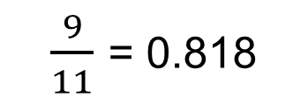
Team's historical velocity (average)
$\frac{9}{11}$ = 0.818

Slide 31
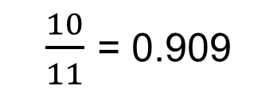
Committed/Completed Ratio
$\frac{10}{11}$ = 0.909

Slide 32
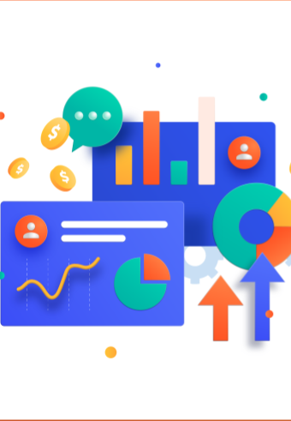
Retrospective

Slide 33
What Went Well
90.9% of the planned tasks Completed
The roadmap for this sprint was created and executed successfully
The core functions have been successfully implemented

Slide 34
What can be improved?
The commitment to completing all the planned tasks needs to be increased, as the 10% of tasks that were not completed may have caused delays in future sprints.
We need to improve our time management skills, as some tasks took longer than expected, which may have impacted other tasks in the sprint.
We need to measure our ability before we plan, and we can't plan what our team can't do. Because of this reason, one goal of the whole project has not been completed.

Slide 35
Live Project Demo
(Sprint 2 – Current Sprint)

Slide 36
Slides App Screenshot

Slide 37
Slides for API
API lists:
pytorch
soundfile
pyaudio
numpy
opencv2
random

Slide 38
Thanks
GitHub link: https://github.com/htmw/2023S-zhu/wiki Live Application Demo: https://youtu.be/RFxMyKje3K0

